Slide 1
CSE Course: STAT-2111 Course title: Theory of Statistics
Prof. Md. Aminul Hoque, PhD
HP: 01715361973
E-mail: aminul@ru.ac.bd
OR
mdaminulh@gmail.com

Slide 2
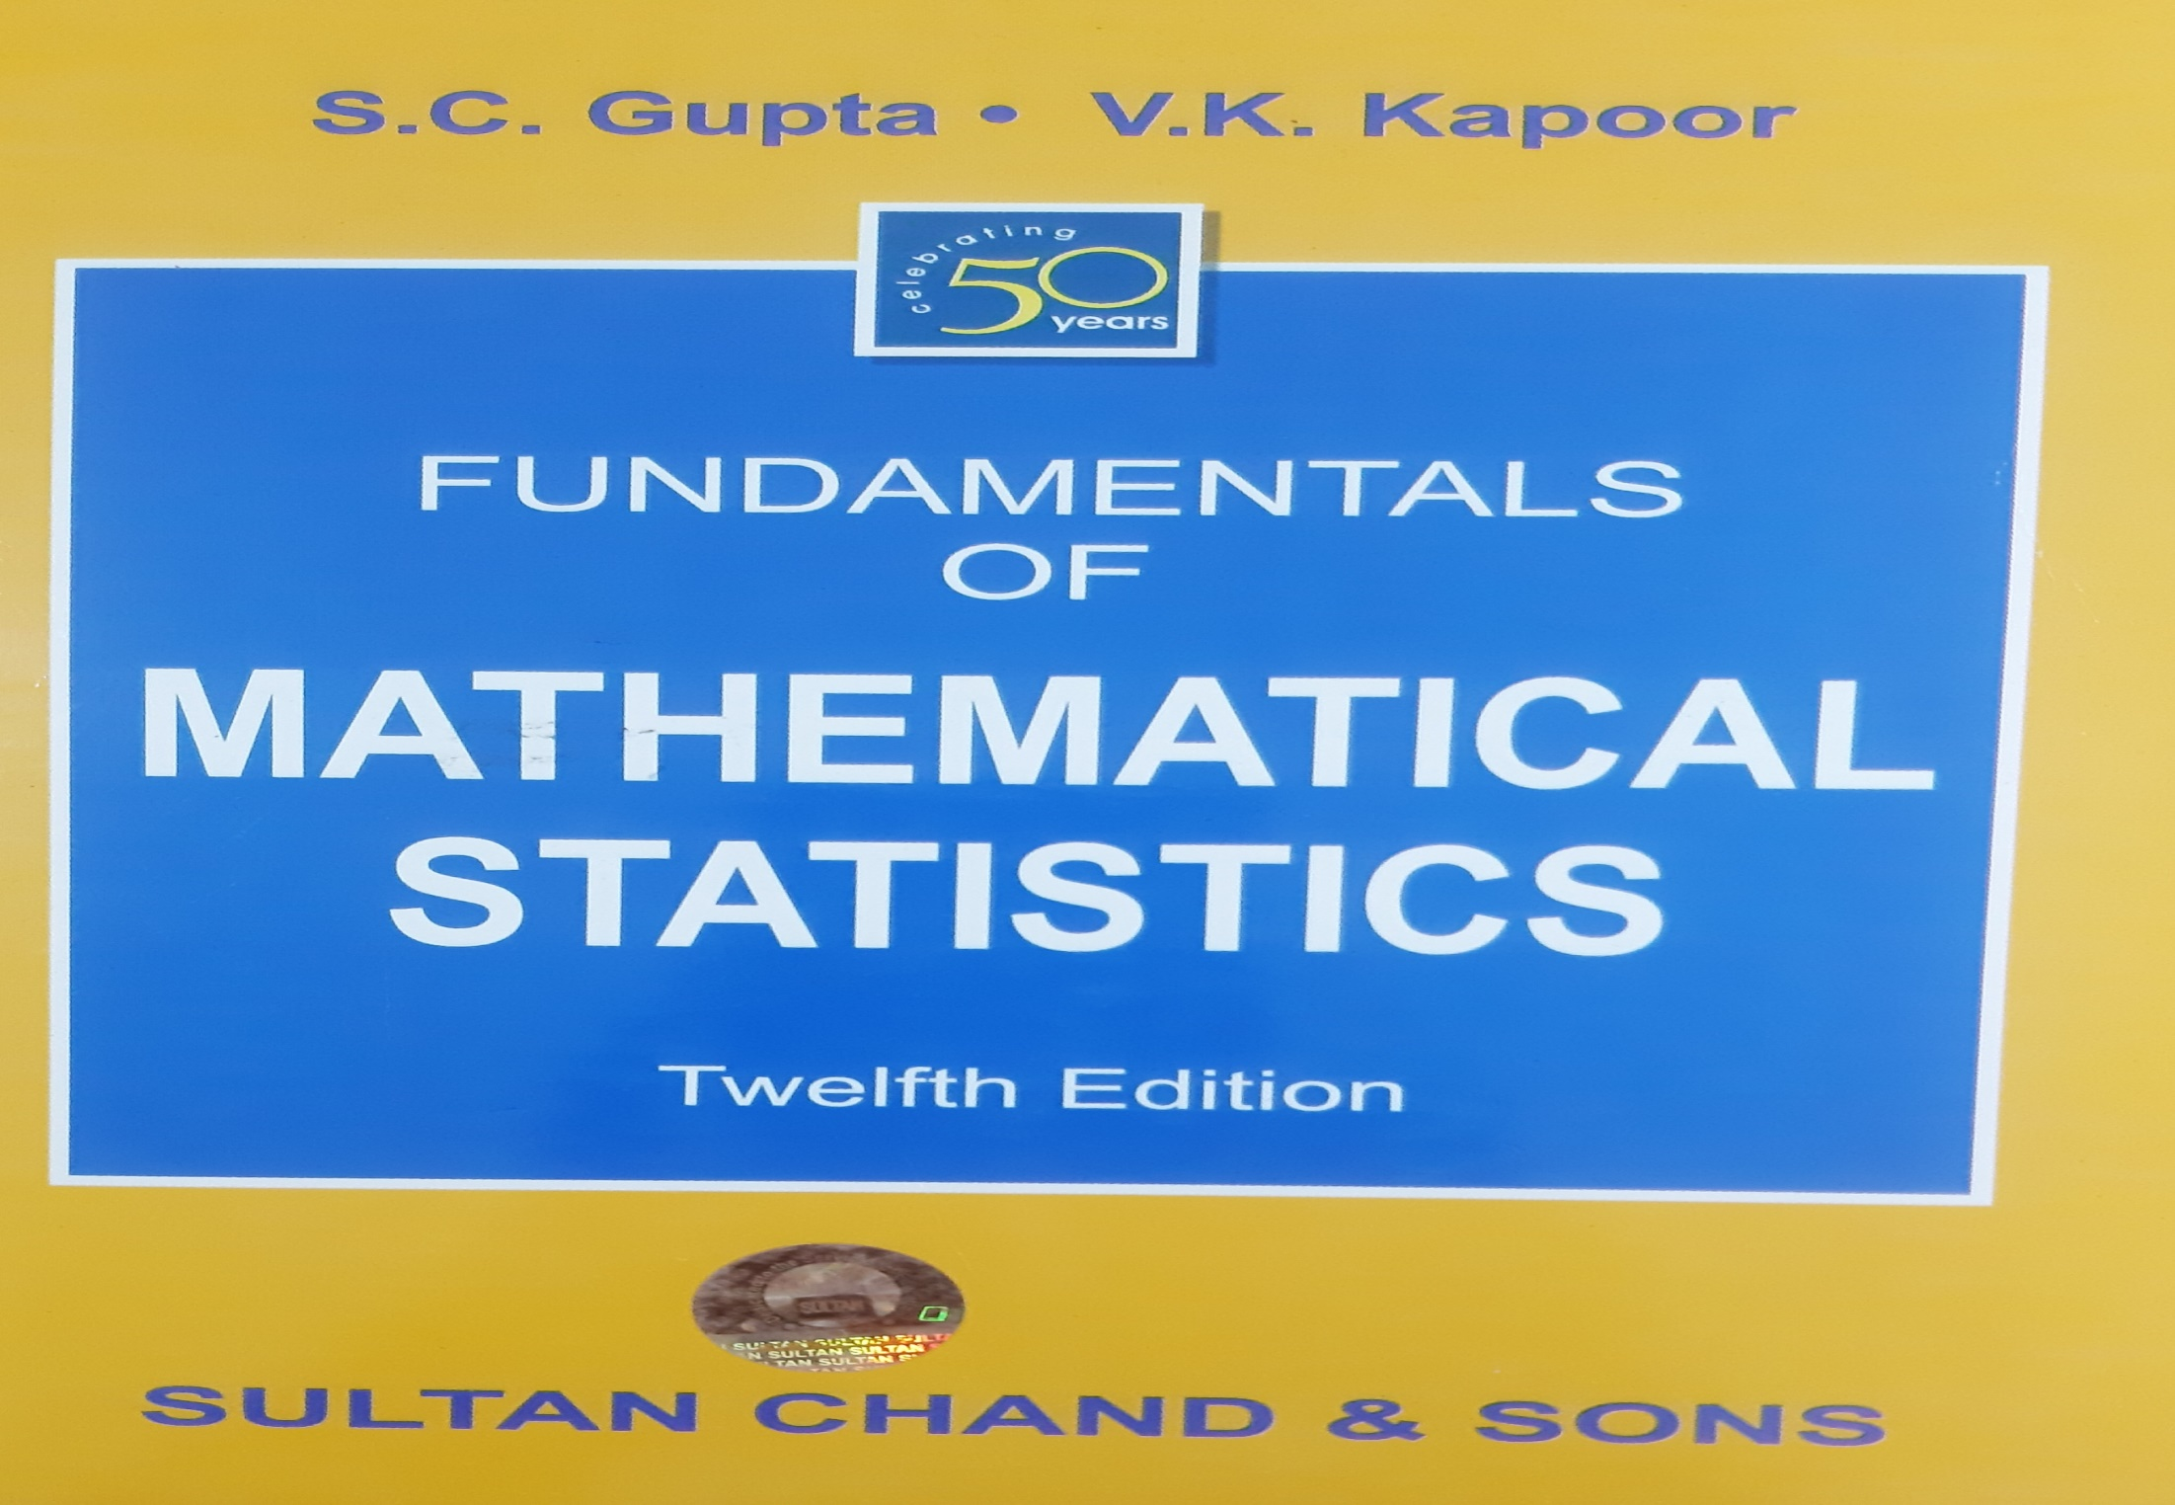
Reference

Slide 3
Chi-square distribution (χ²-distribution)
A chi-square (Χ²) distribution is a continuous probability distribution that is used in many hypothesis tests. The Chi-square distribution may be defined as the “Sum of the squares of independent normally distributed variables with zero means and unit variances”.
The square of a standard normal variate is known as a chi-square variate (pronounced as Ki-Sky without S) with 1 d.f.

Slide 4
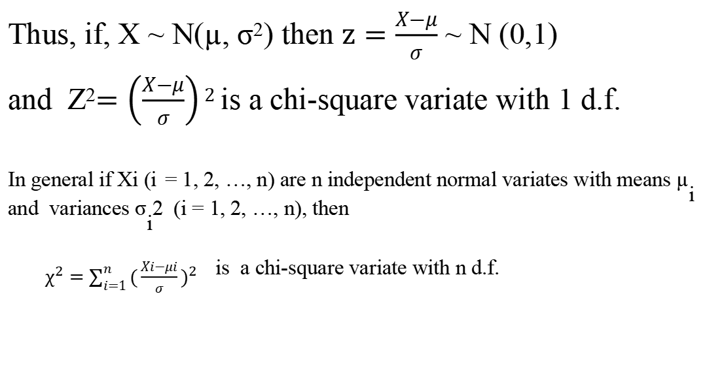
Chi-Square Distribution
Thus, if, X ~ N(µ, σ²) then $z=\frac{X−μ}{σ}$ ~ N (0,1)
and Z²$=\left(\frac{X−μ}{σ}\right)2$ is a chi-square variate with 1 d.f.
^{In general if Xi (i} = 1, 2, …, n) are n independent normal variates with means µ_{i} ^{and variances σ}_{i}^{2 (i = 1, 2, …, n), then}
$χ^{2}=\sum_{i=1}^{n}{{(\frac{Xi−μi}{σ})}^{2}}$ is a chi-square variate with n d.f.

Slide 5
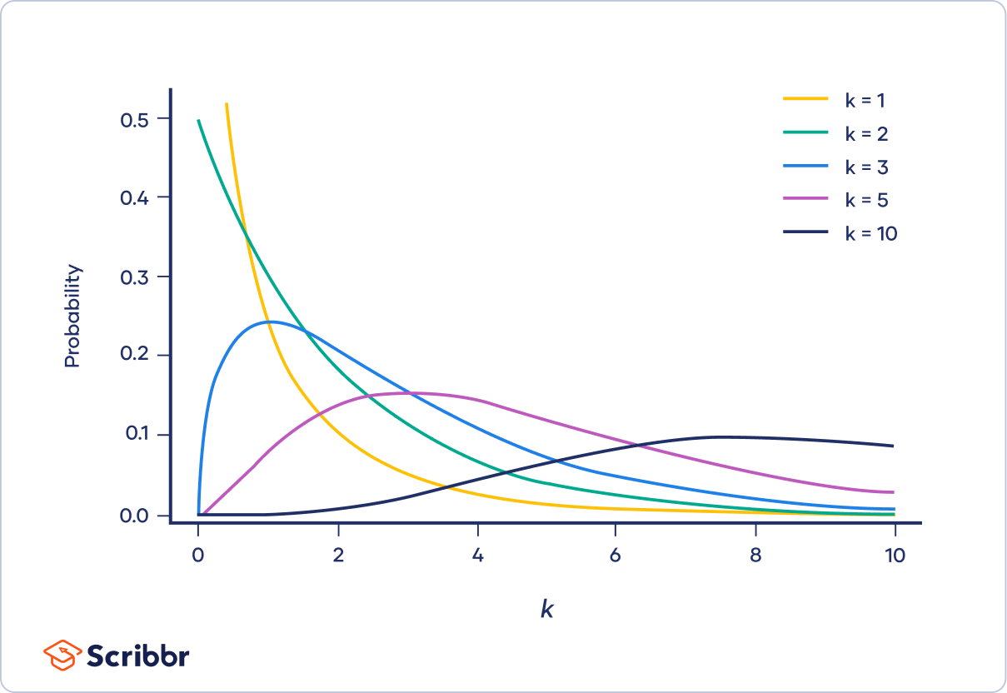
The shape of a chi-square distribution is determined by the parameter k. The graph below shows examples of chi-square distributions with different values of k.

Slide 6
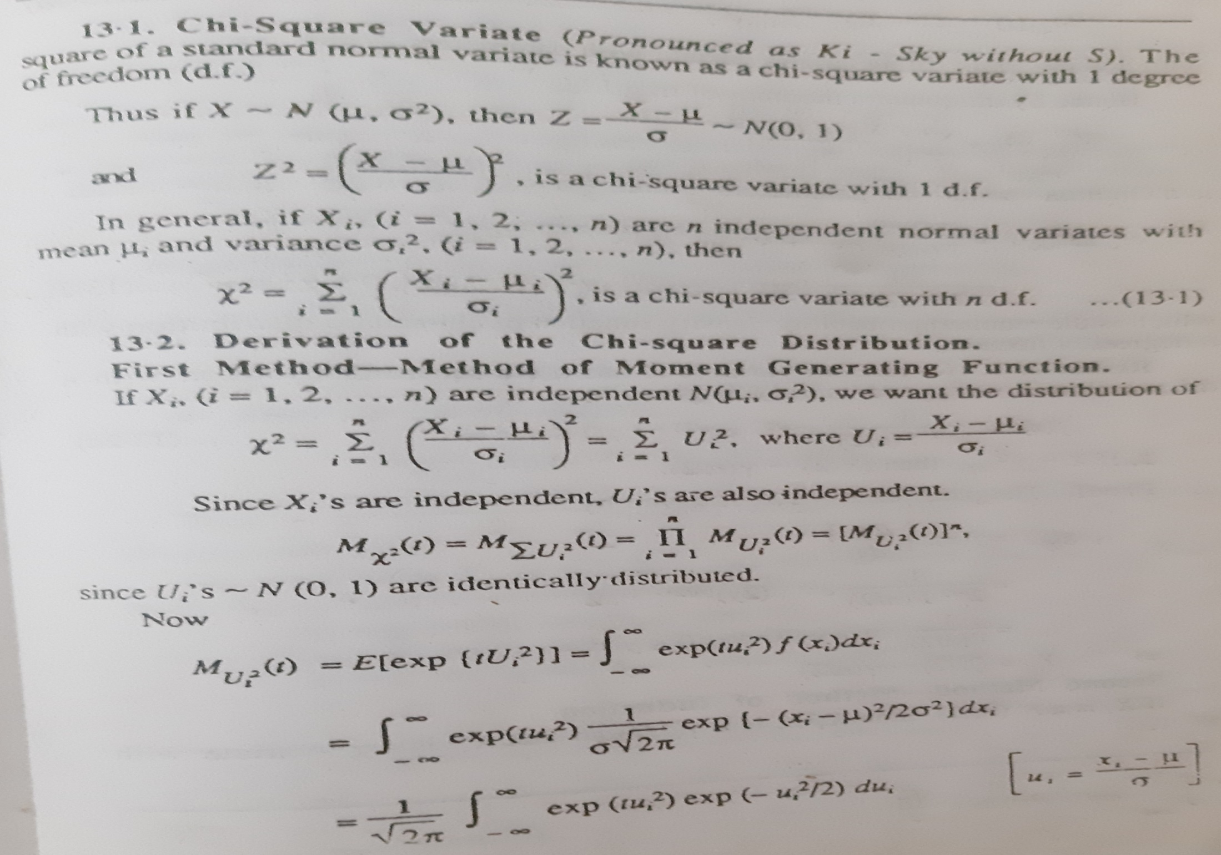
Chi-Square Distribution

Slide 7
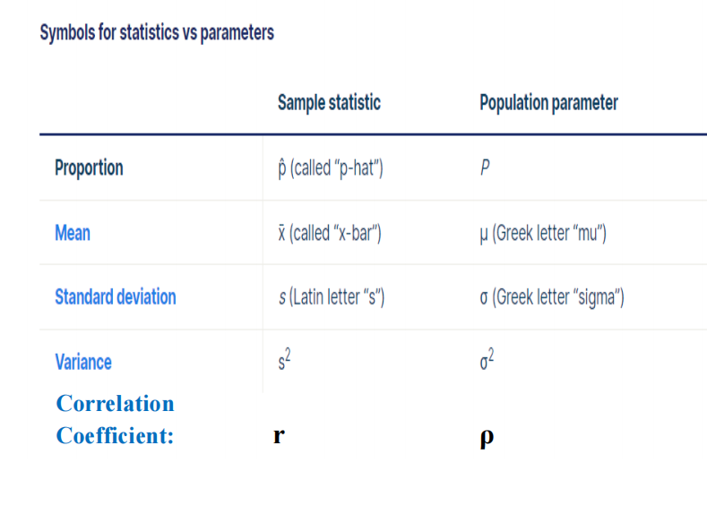

Slide 8
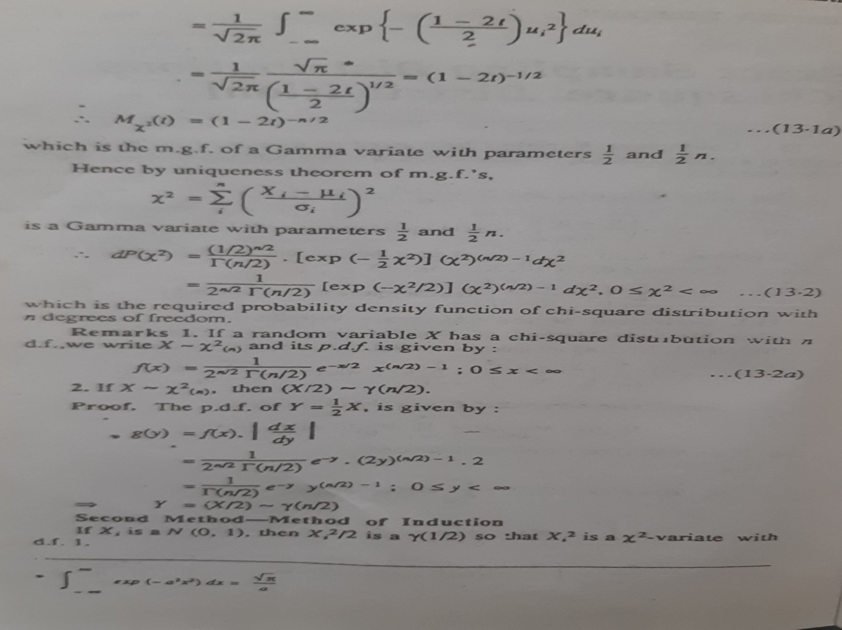

Slide 9
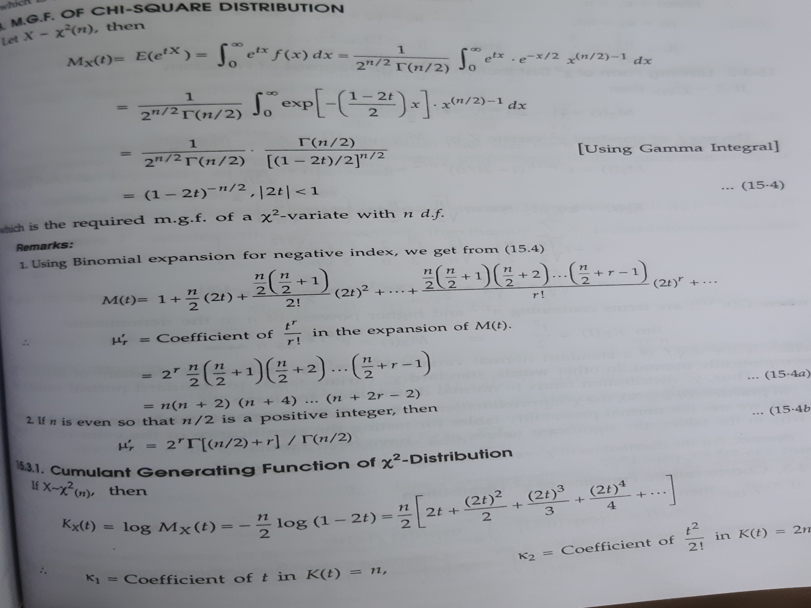

Slide 10
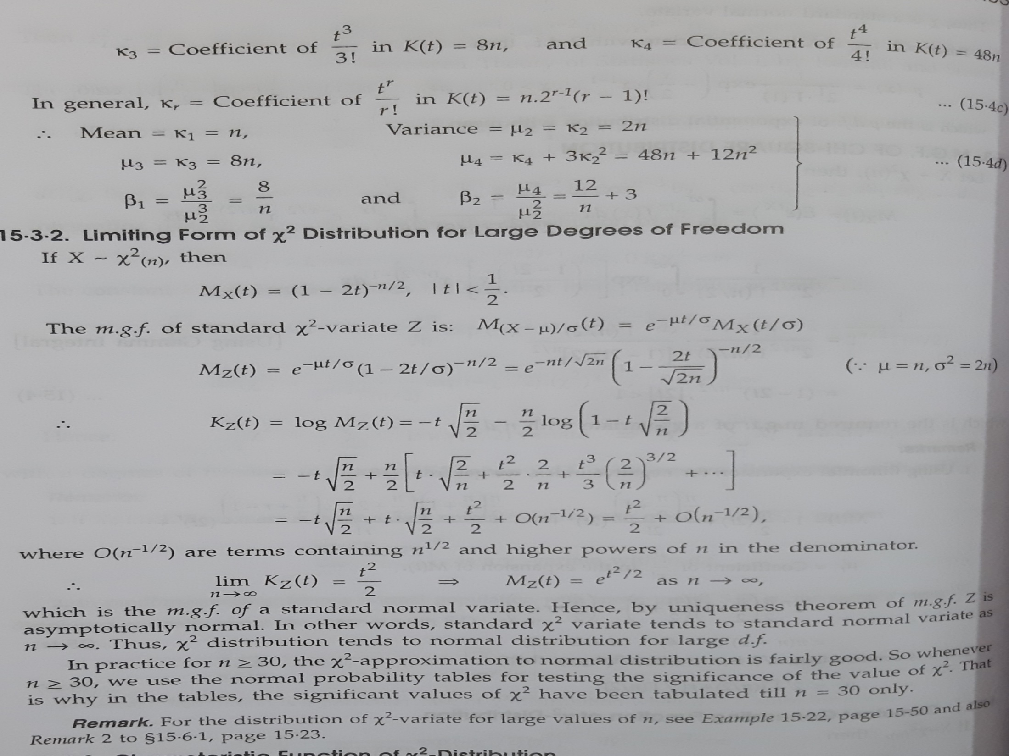

Slide 11
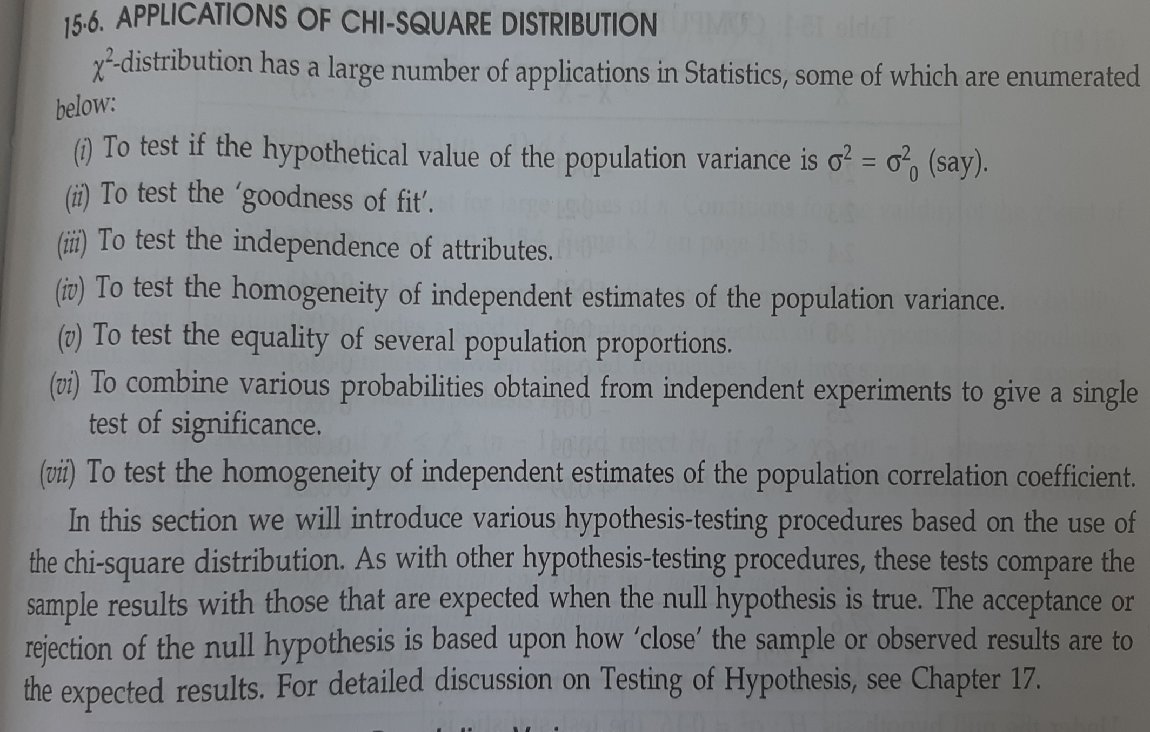
Applications of Chi-Square Distribution

Slide 12
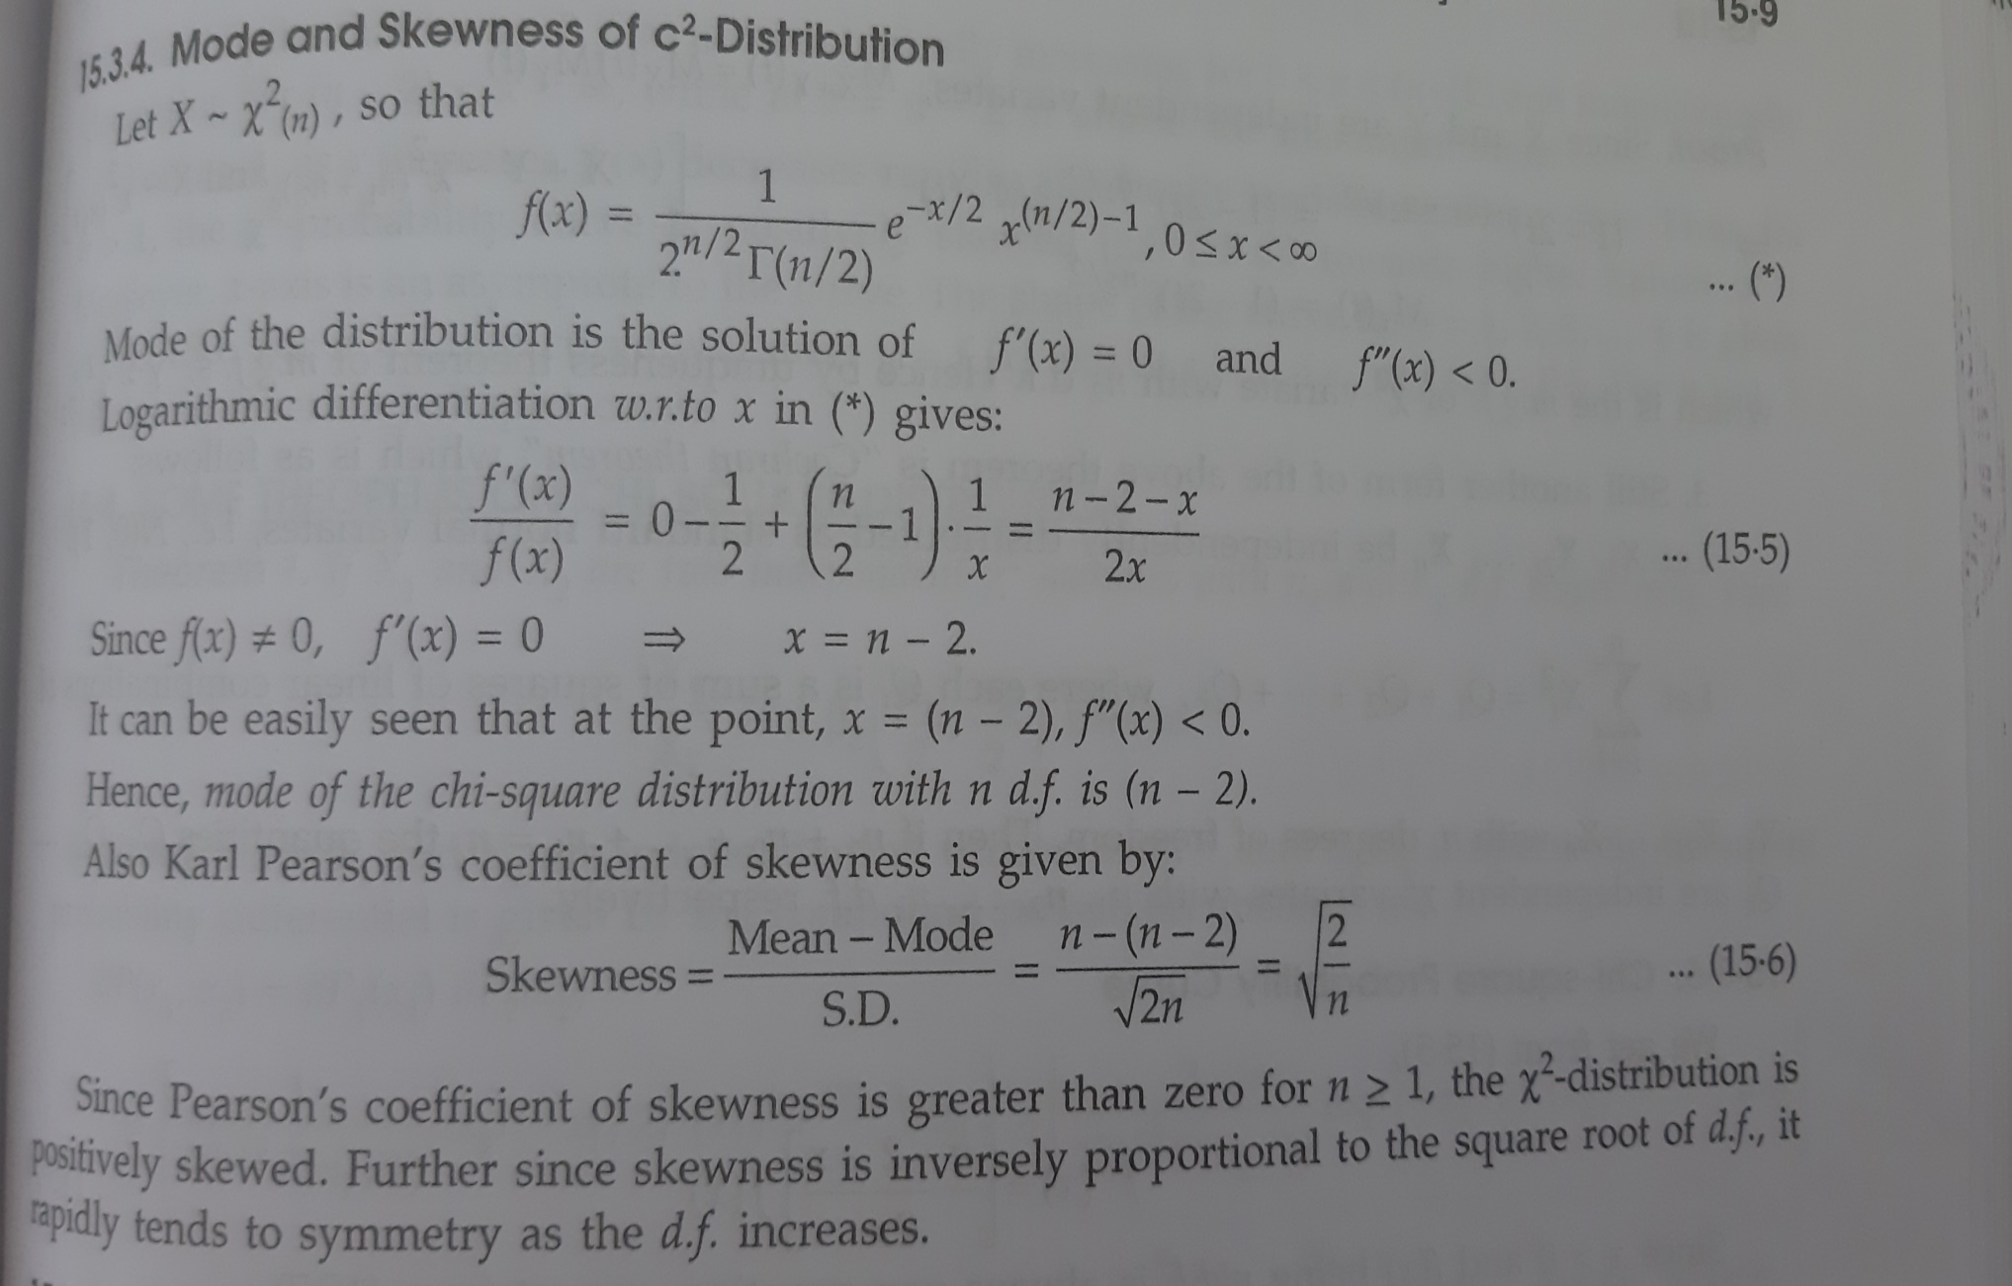
Mode of Chi-square distribution

Slide 13
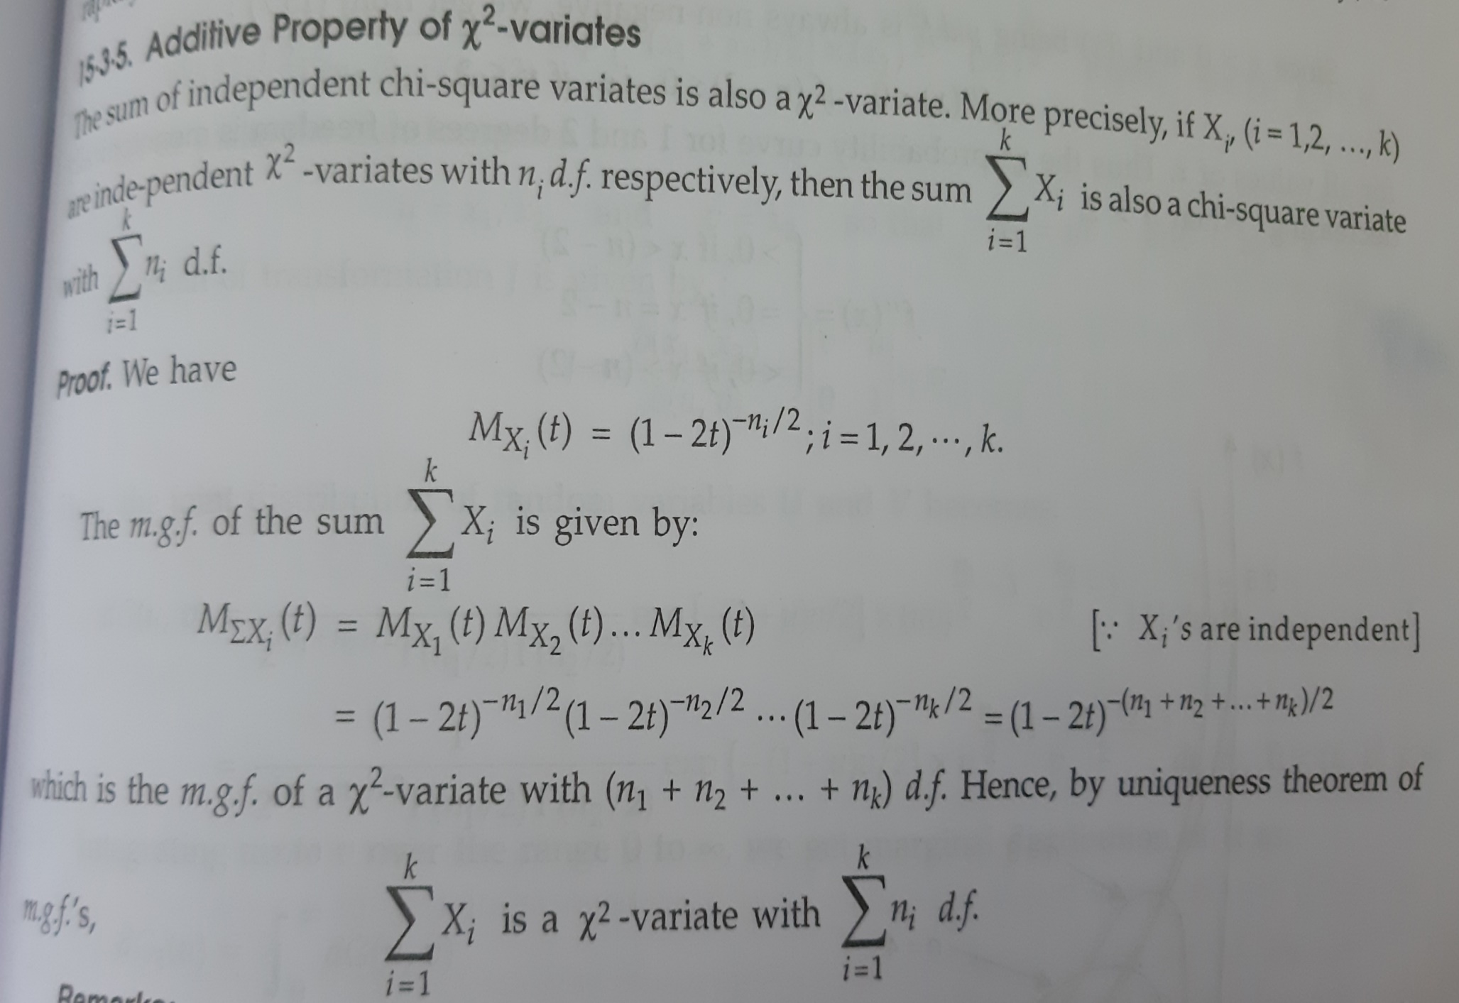
Additive Properties

Slide 14
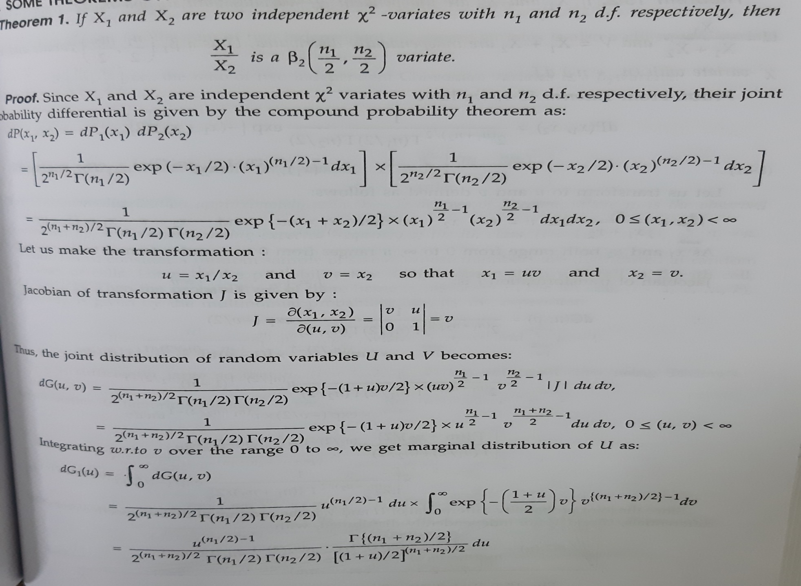

Slide 15
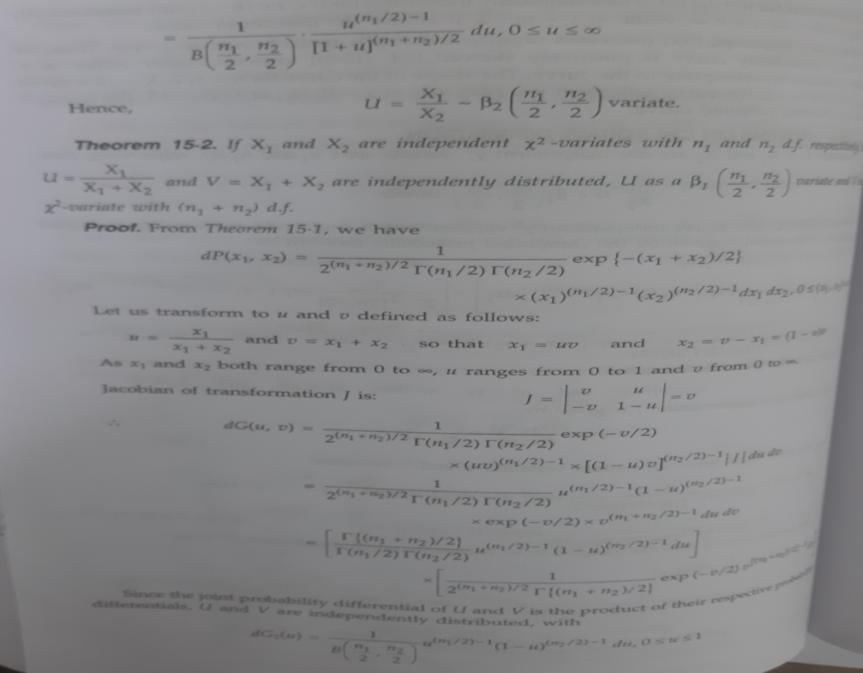

Slide 16
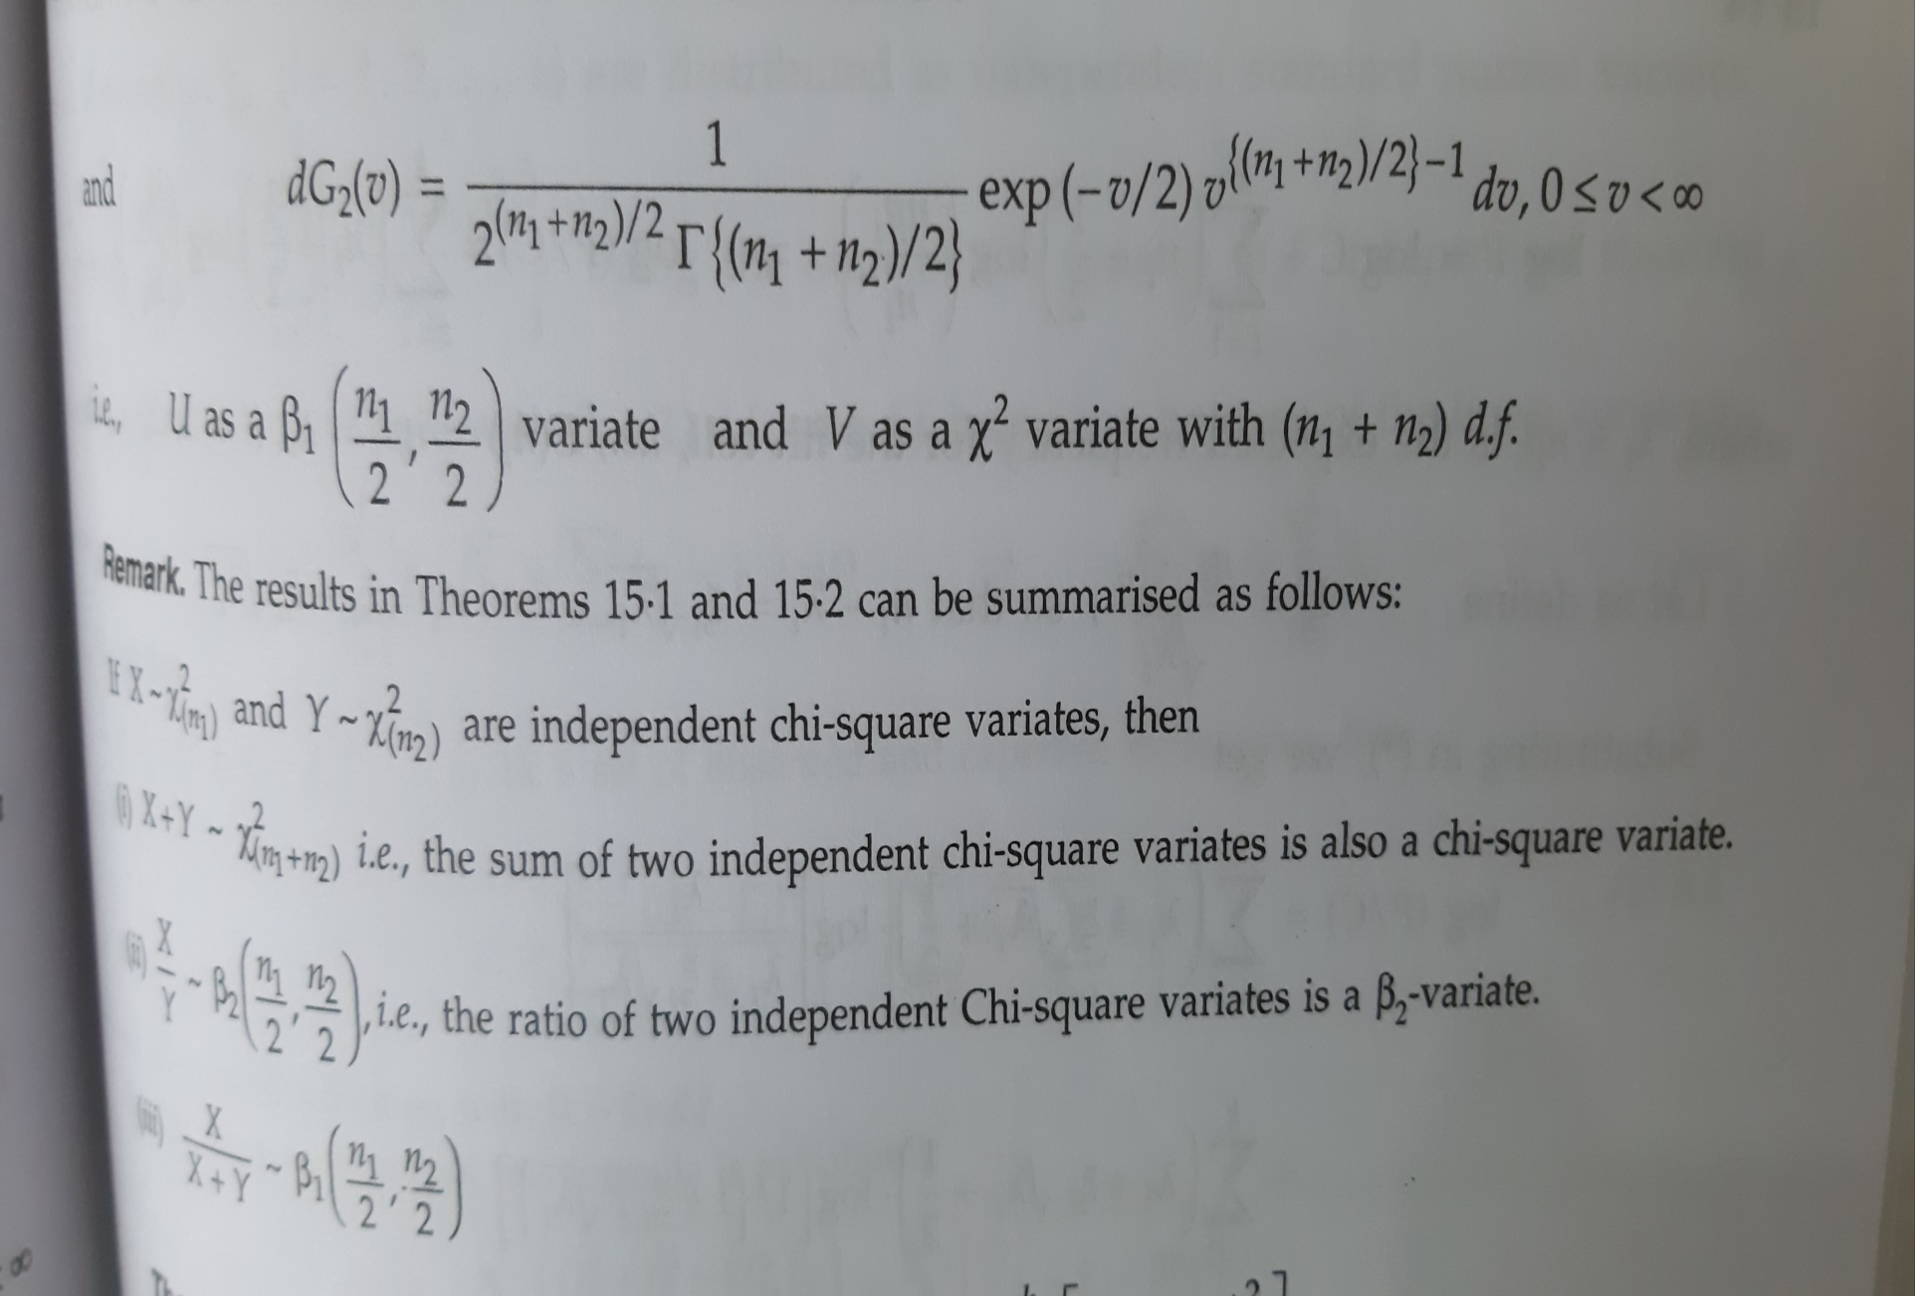

Slide 17
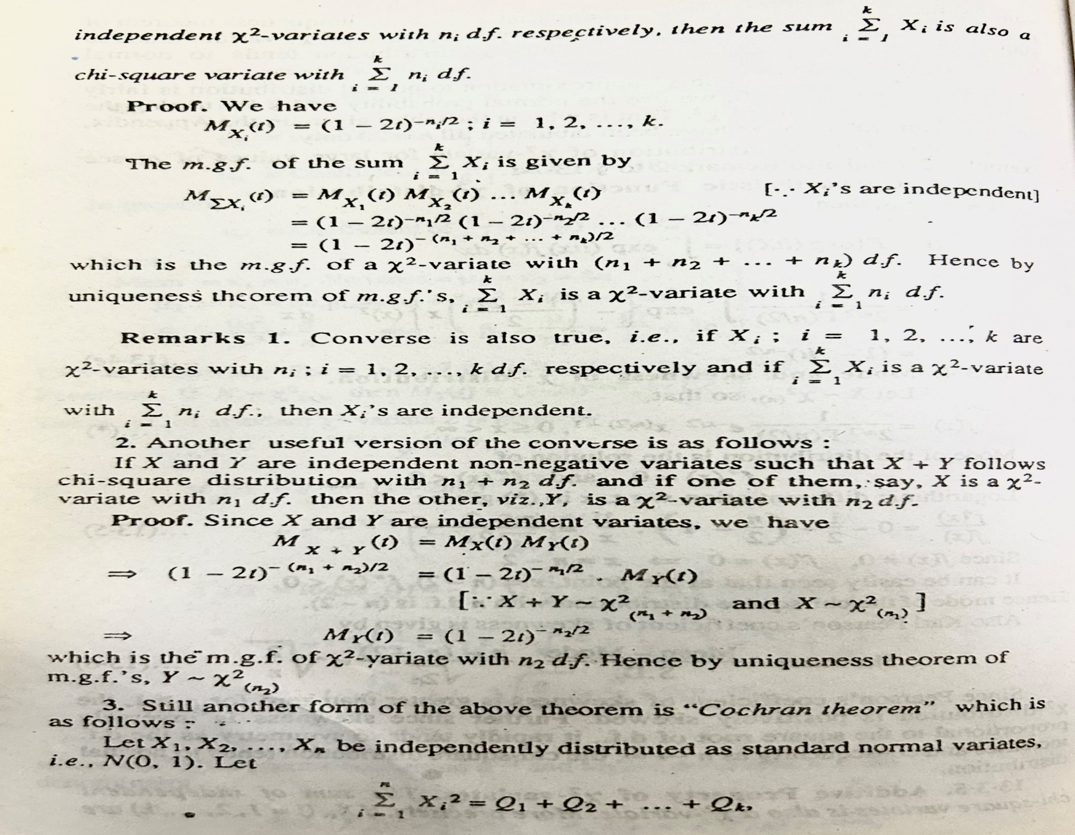

Slide 18
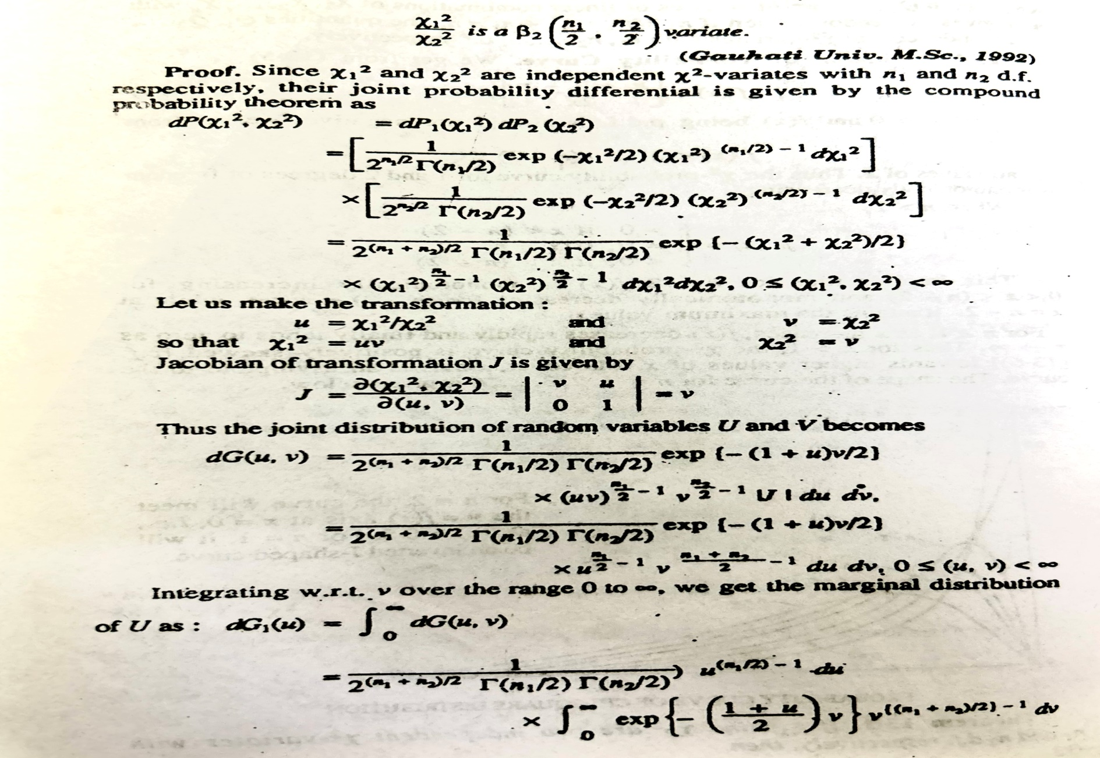

Slide 19
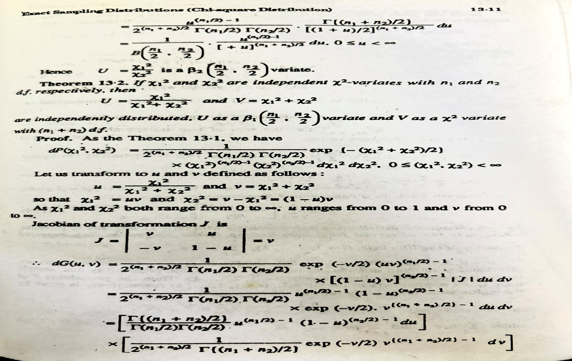

Slide 20
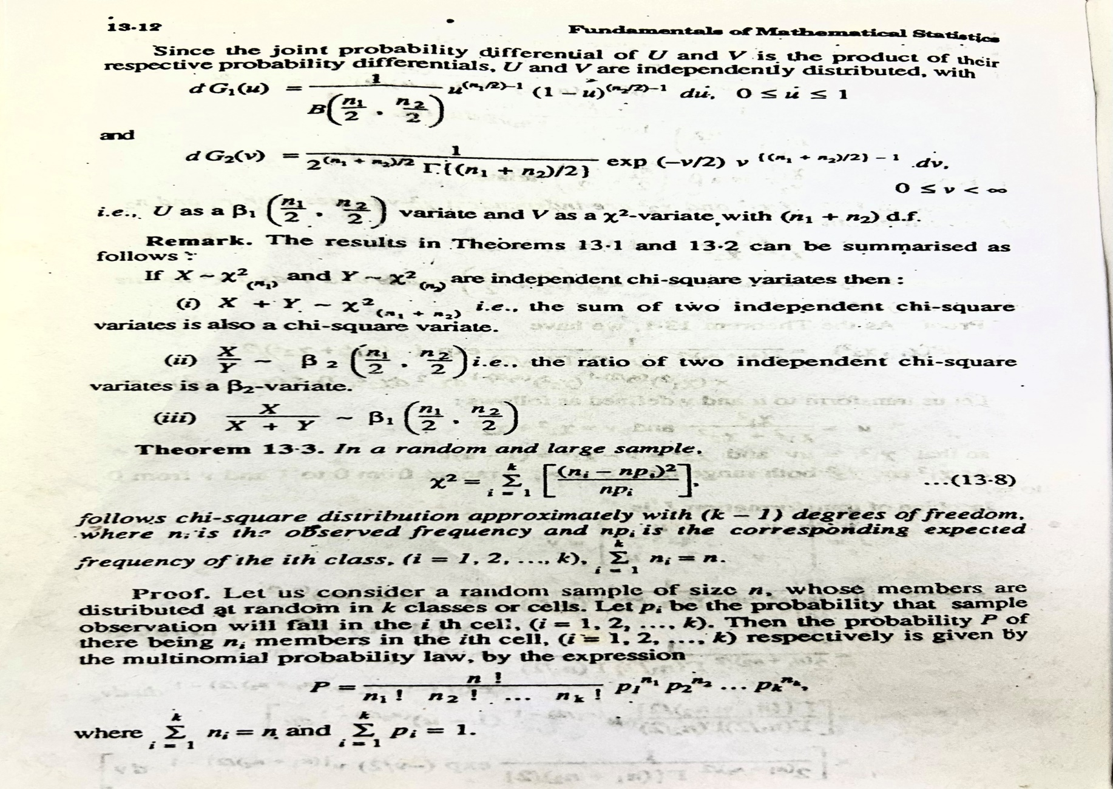

Slide 21
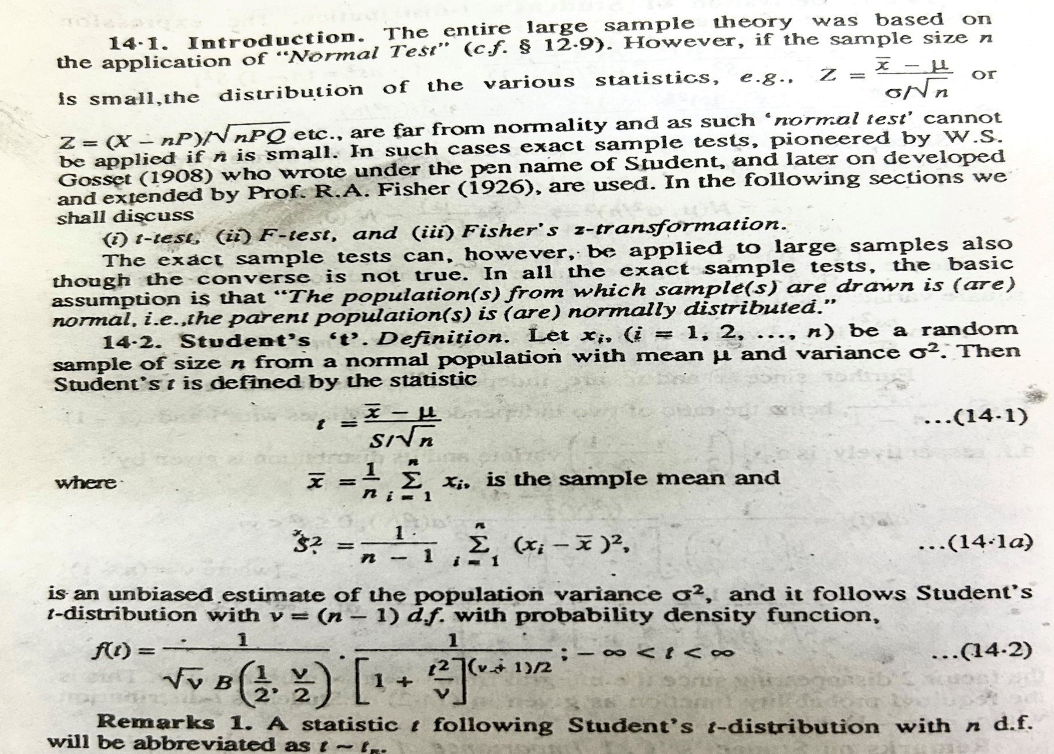
Student t-Distribution

Slide 22
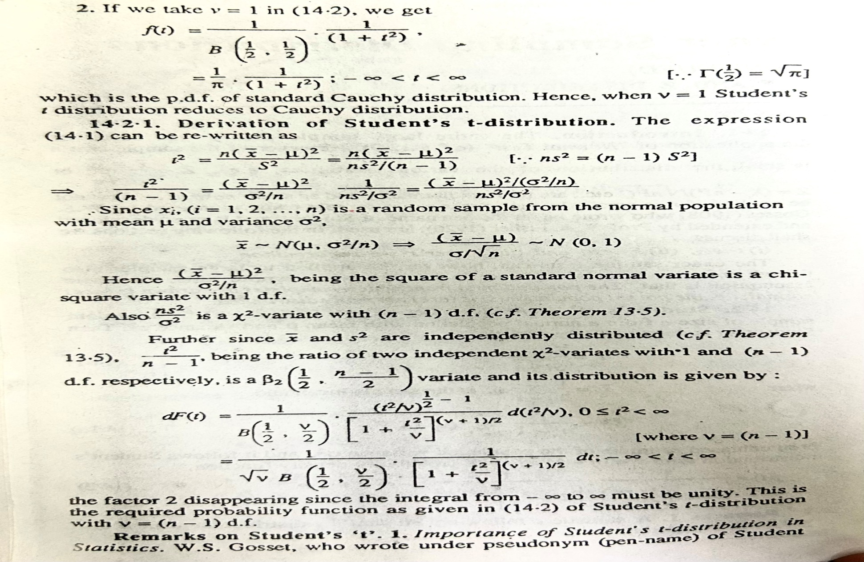

Slide 23
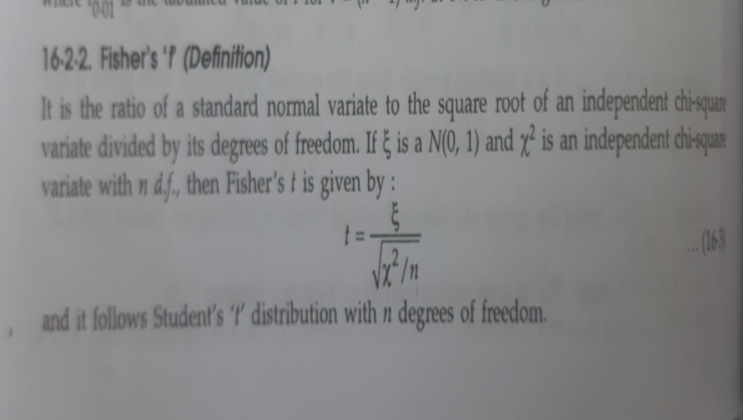
Fisher t-distribution

Slide 24
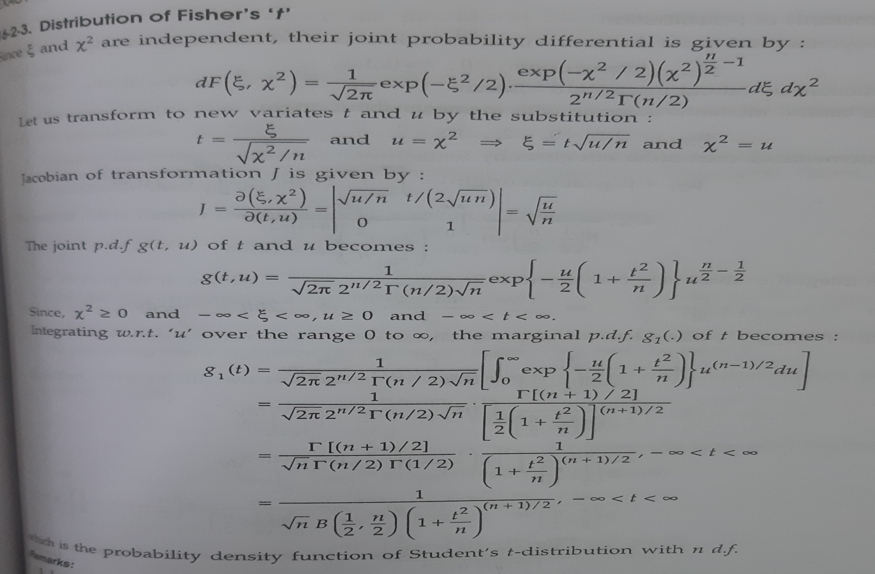
Fisher t distribution

Slide 25
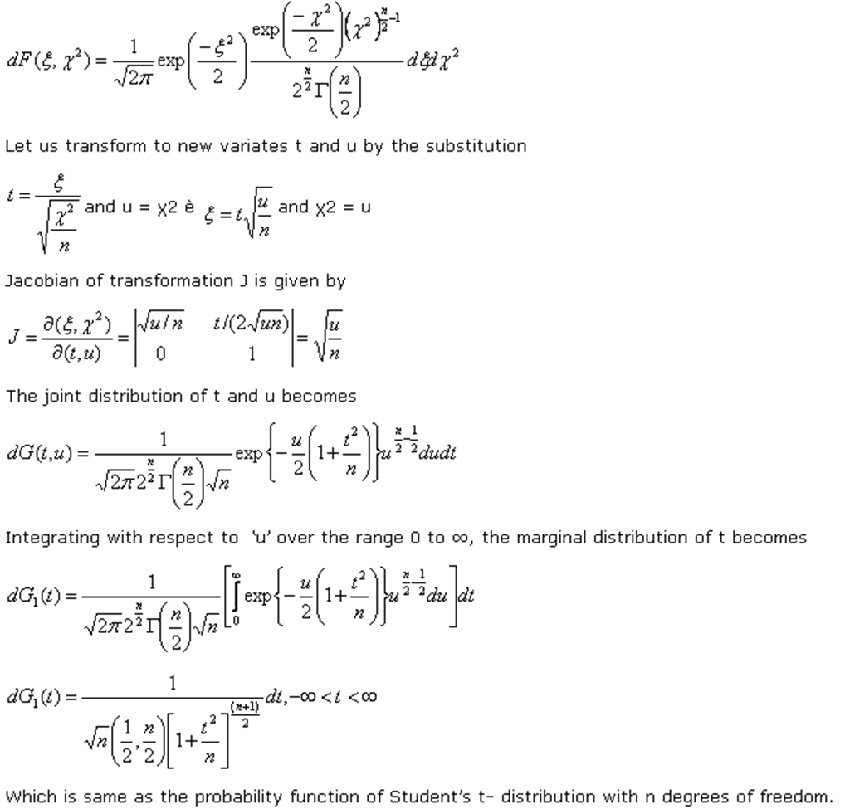

Slide 26
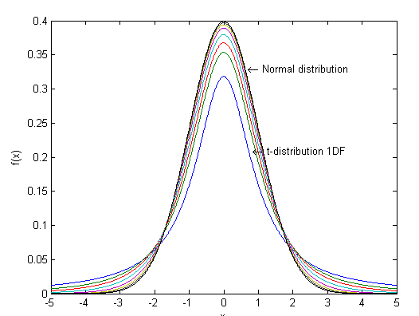
Graph of T ditibution

Slide 27
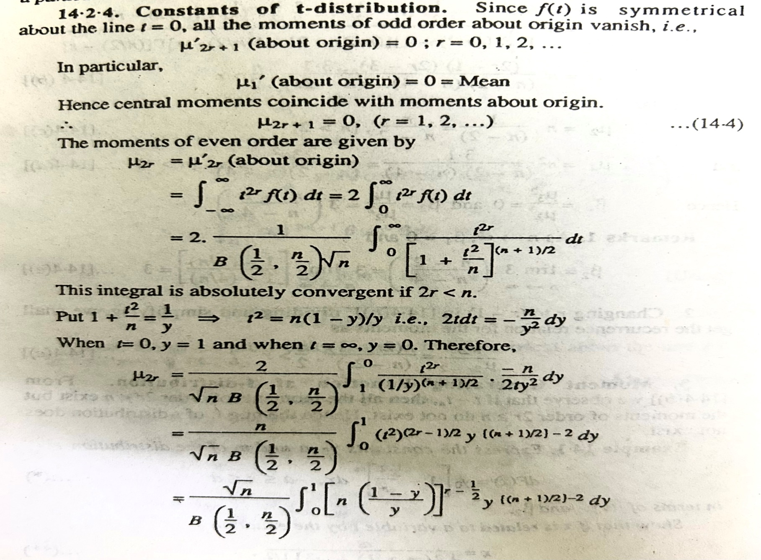
Constants of t-distribution

Slide 28
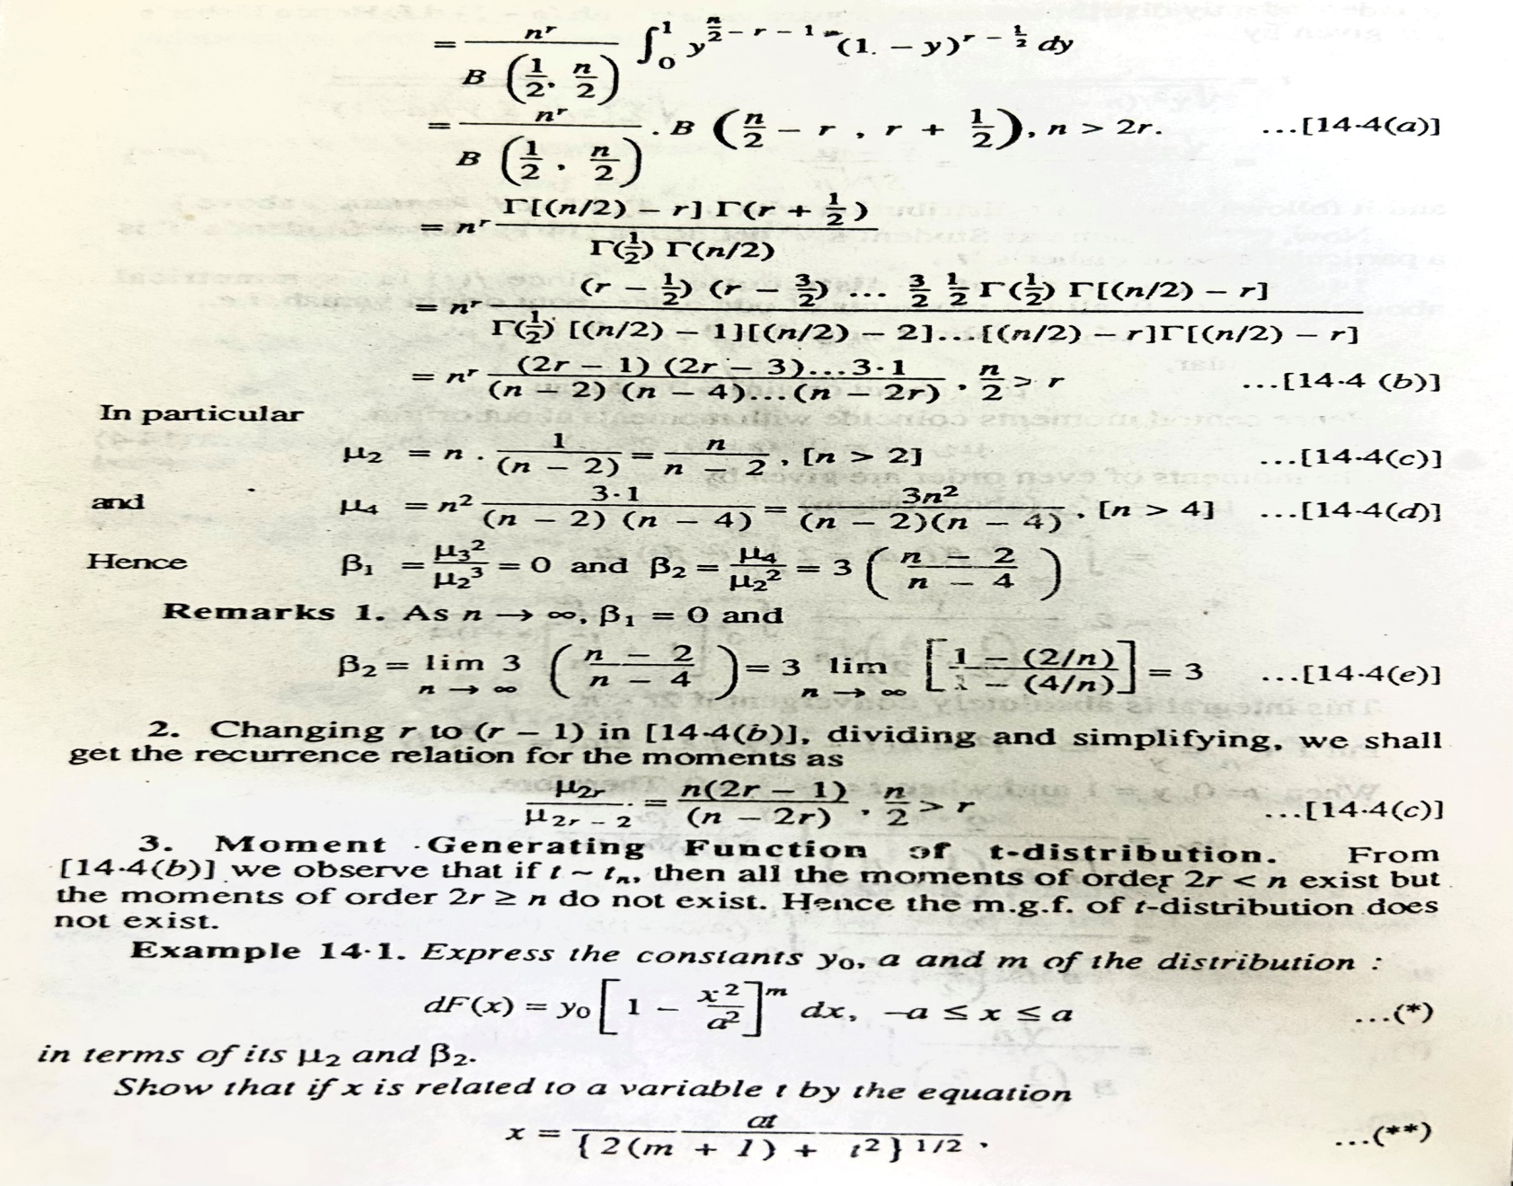

Slide 29
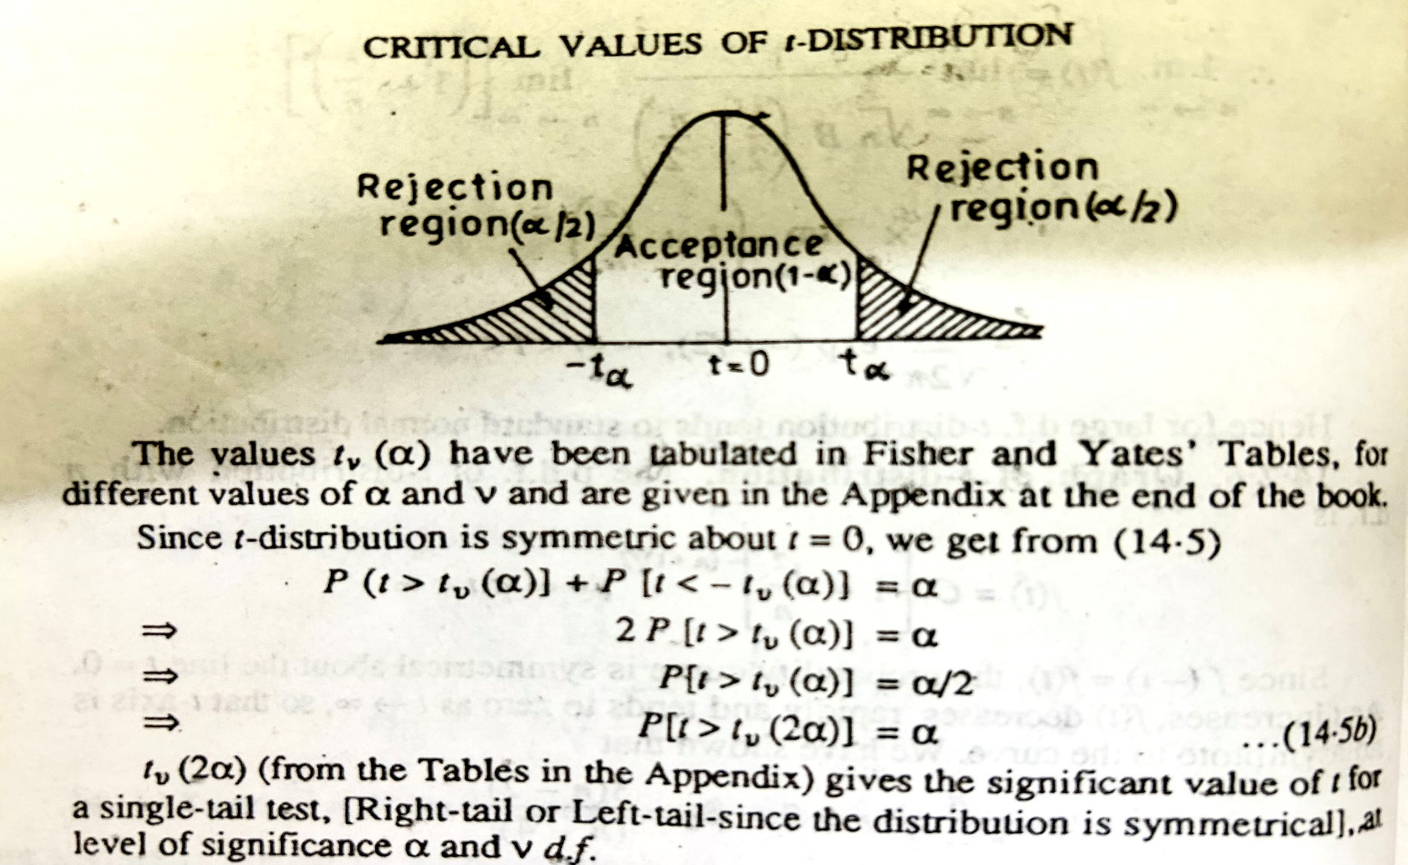
Critical Values

Slide 30
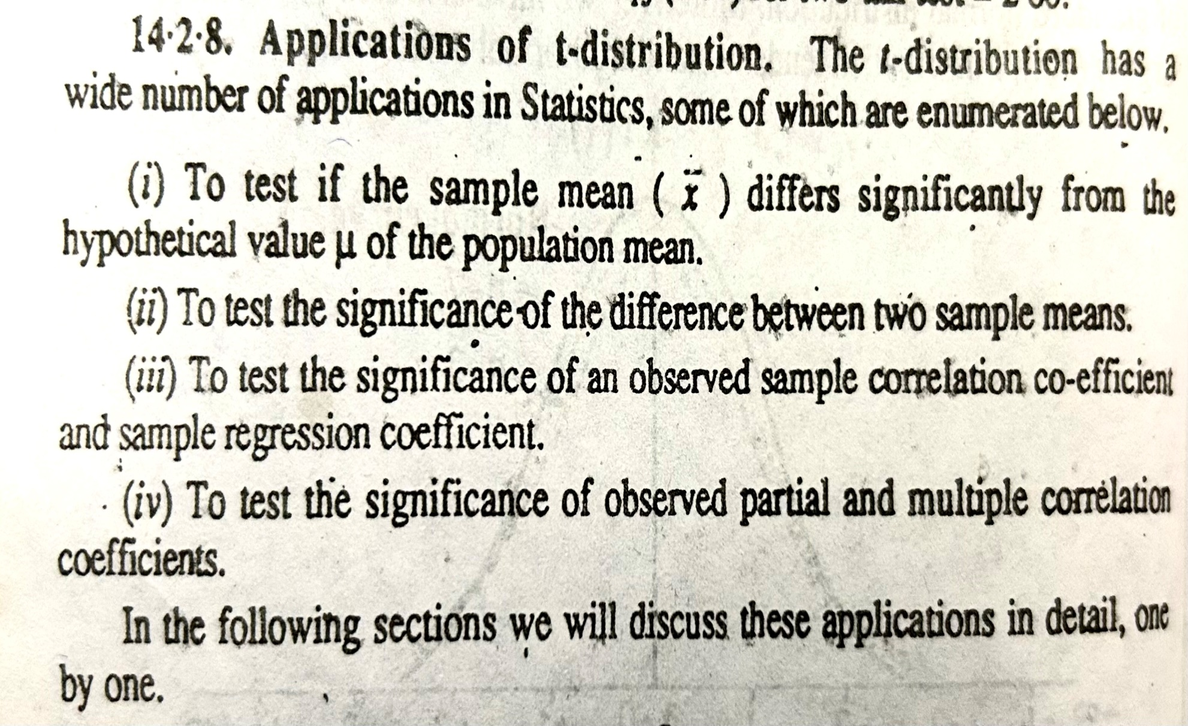
Applications of t-distribution

